Slide 1
EZ Coders
Uzma,Daniel,Darren,Jessica,Dwayne

Slide 2
Dashboard on how AMI is affected by Covid19
This project is to explore the possibly correlation of AMI case to the rise of Covid19 cases across the United States

Slide 3
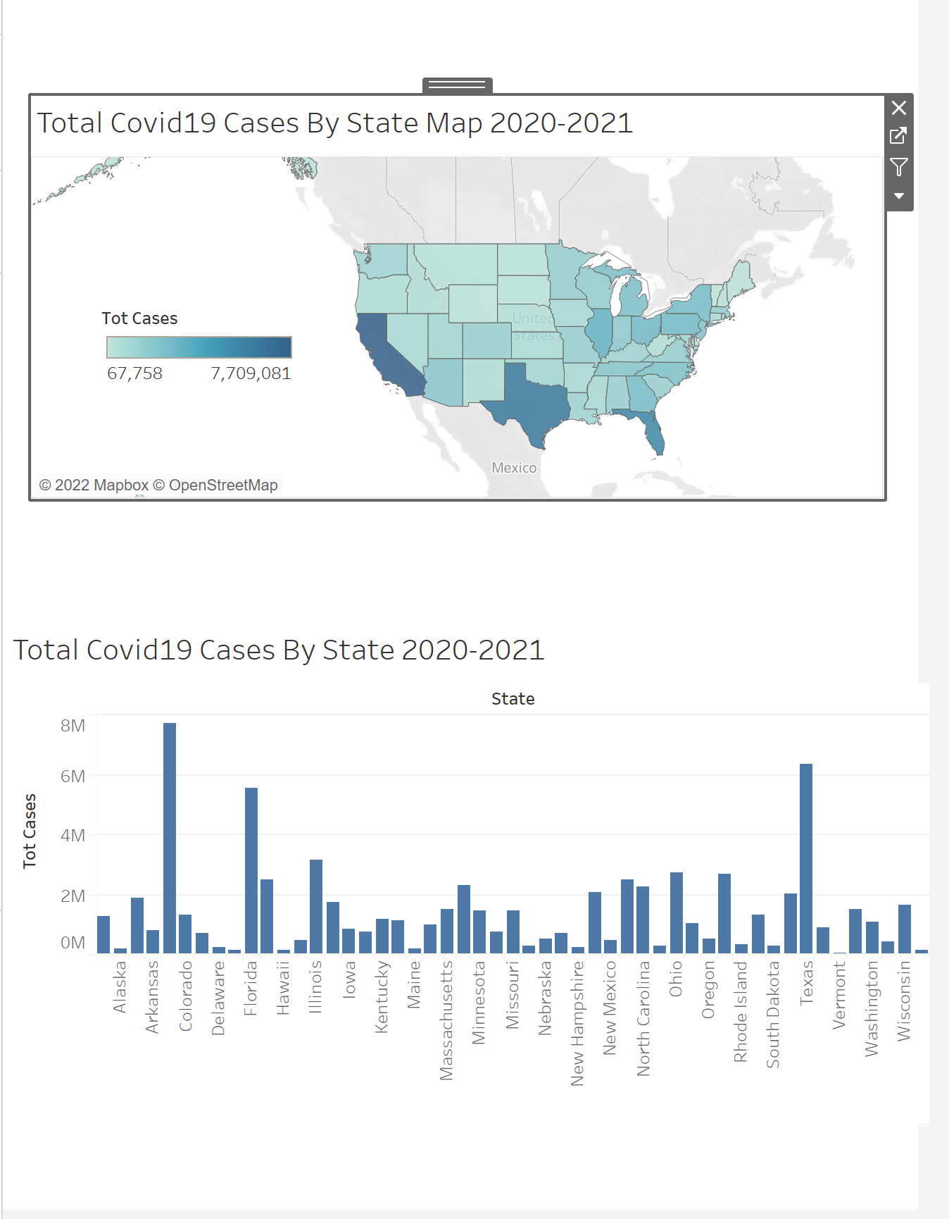
Covid19 cases across the United States

Slide 4
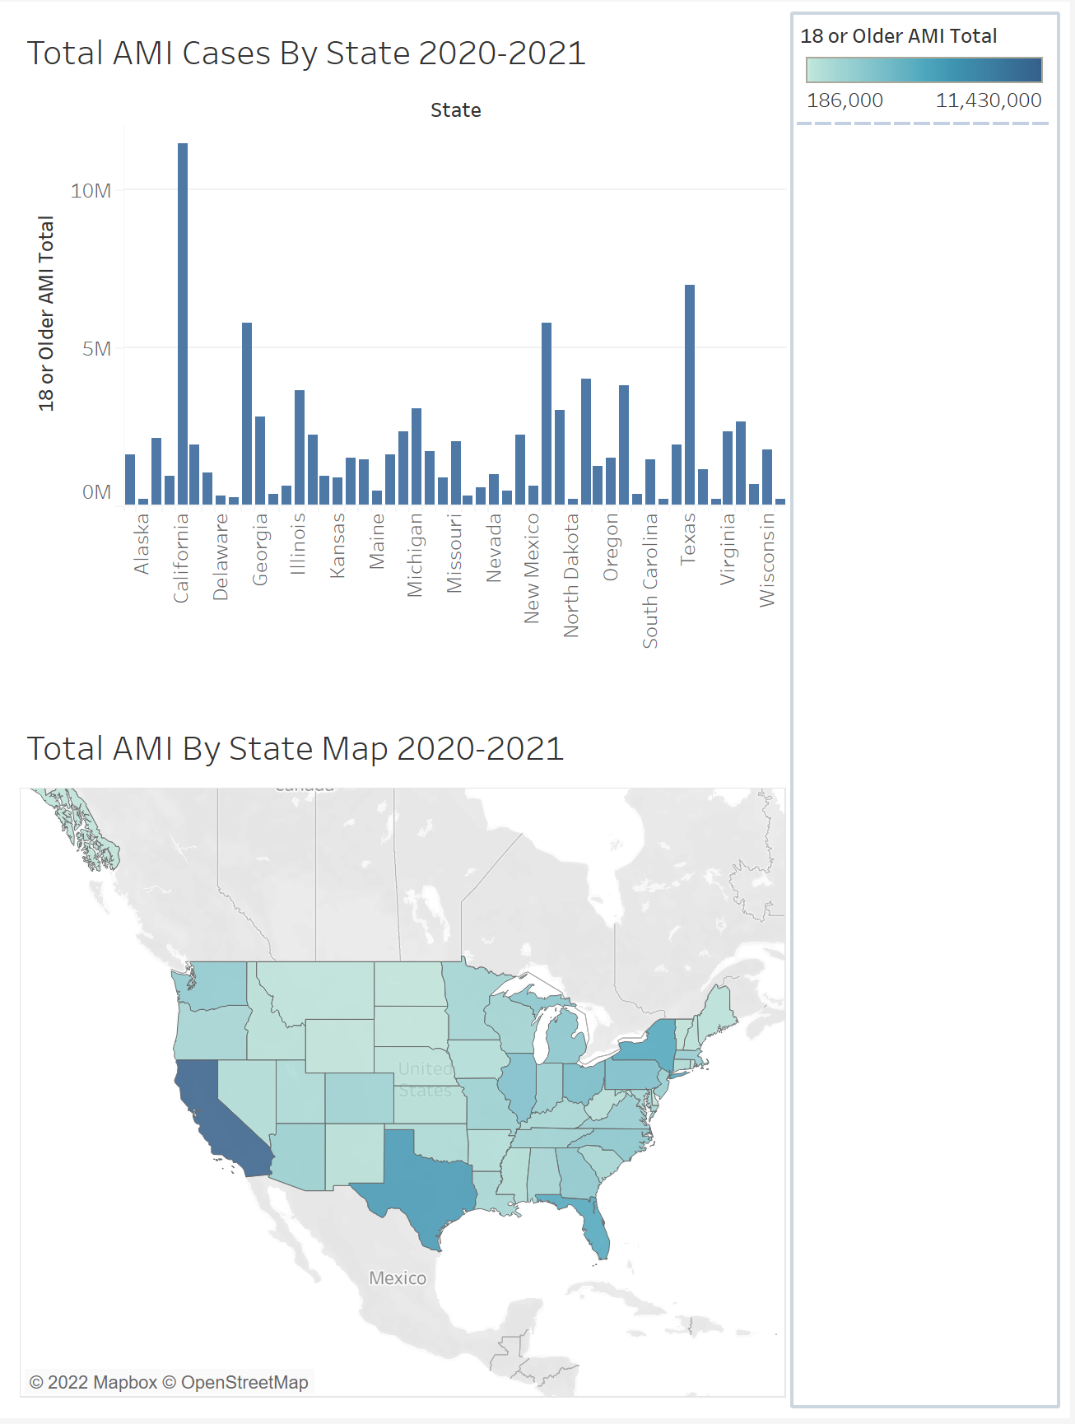
AMI cases across the US for adults 18 or older

Slide 5
Tools to be used in creation of final dashboard
Final Dashboard we will use Filters, Summary Statistics and Graphs. These tool will give the user control over the data, by being able to select particular states for viewing. We will also use Heroku and Flask as a part of our interactive deployment

Slide 6
Analysis
Our analysis will be to determine the states with the highest correlation between covid19 and AMI cases. From this analysis we will determine and advise mental health clinics/centers for the states/areas affected the most.

